Slide 1
Random Forest Classifier: Feature Selection Criteria
By: Steven Cocke

Slide 2
Agenda
Context Decision Tree Defined
Random Forest as a Classifier
Split Criterion and Feature Selection
Entropy
Gini Index
Information Gain
SkLearn
Gini vs. Entropy

Slide 3

Context
Decisions Decisions…
Whether you know it or not…you use decision trees every day!

Slide 4
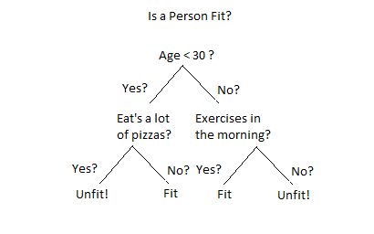
Context
Example: if you were asked to make a judgment call about someone’s fitness…maybe it would look like this

Slide 5
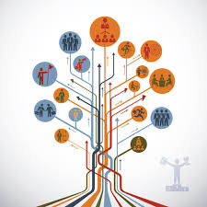
What is a Decision Tree?

Slide 6
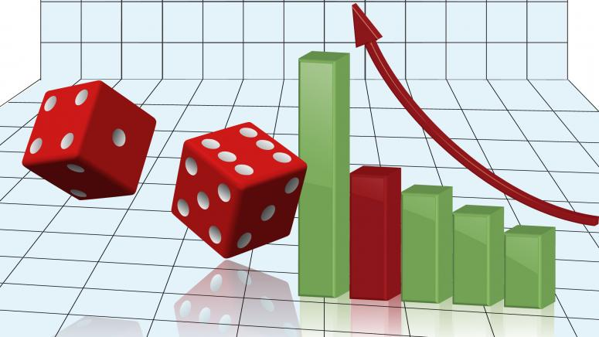
Decision Tree Defined
A decision tree is a diagram that people use to make a decision or show a statistical probability.
In most cases, used for prediction

Slide 7
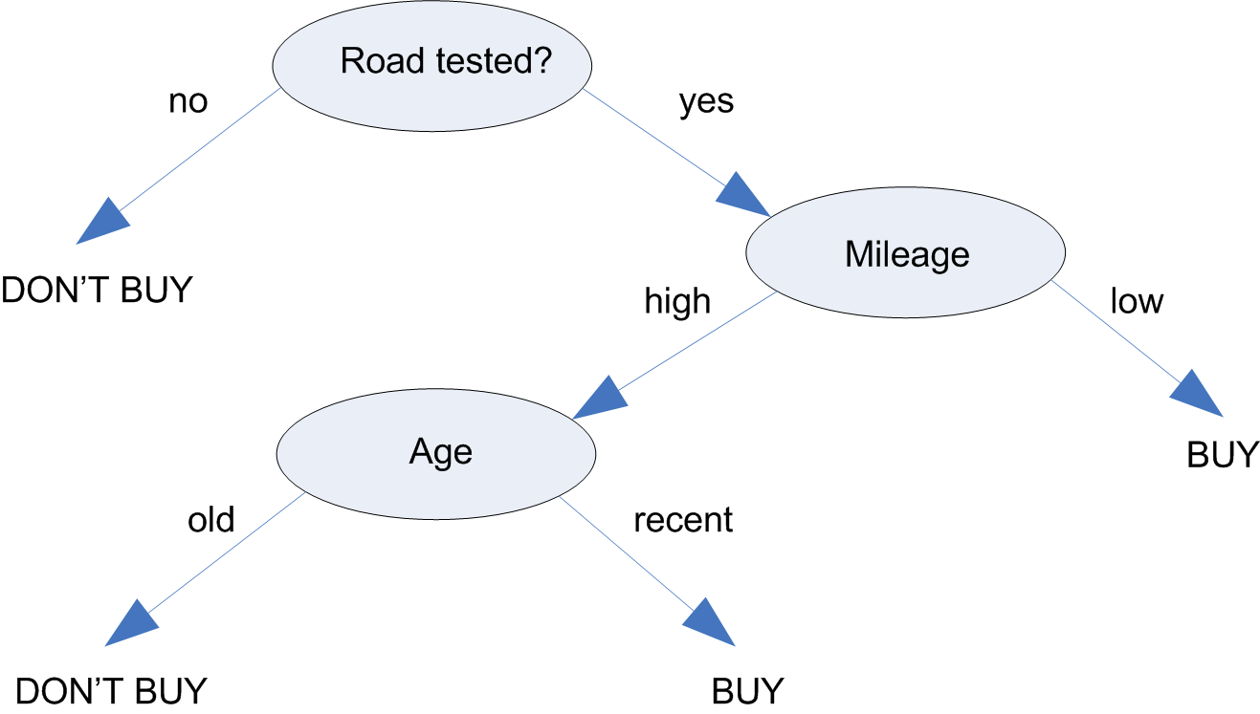

Slide 8
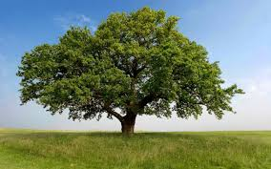
Decision Tree Terms
Root Node
Parent Node
Child Node
Leaf

Slide 9


Slide 10
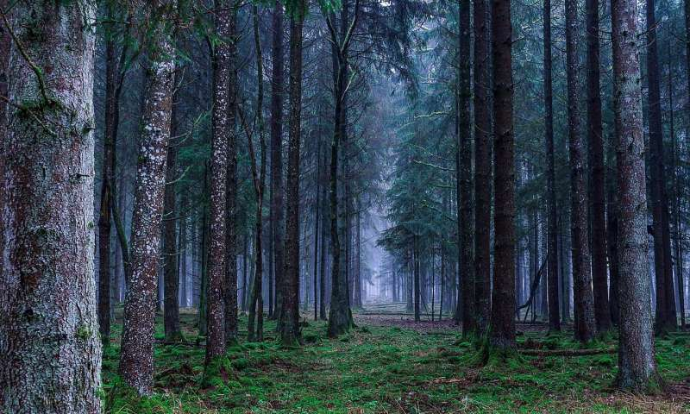
What is a Random Forest?

Slide 11

Random Forest Classifier
Random forest, like its name implies, consists of a large number of individual decision trees that operate as an ensemble. Each individual tree in the random forest spits out a class prediction and the class with the most votes becomes our model’s prediction.

Slide 12
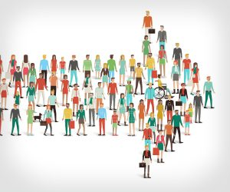
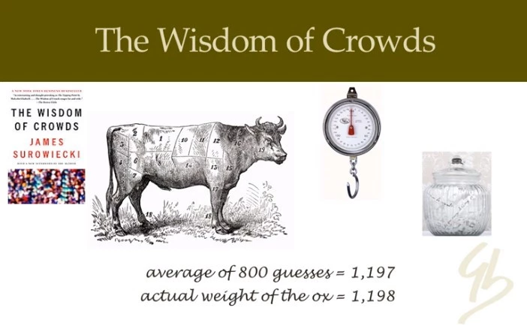
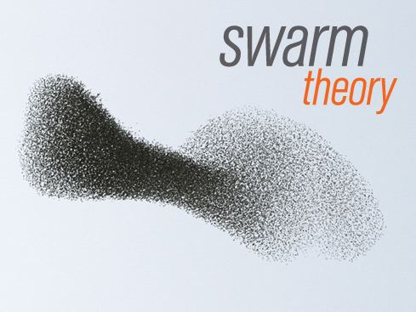
Simply put…
Wisdom of crowds!

Slide 13
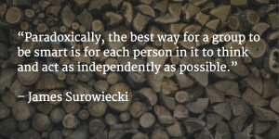
Why is this useful?
A large number of relatively uncorrelated models (trees) operating as a committee will outperform any of the individual constituent models.

Slide 14

Question
So what makes a decision tree or random forest good?

Slide 15
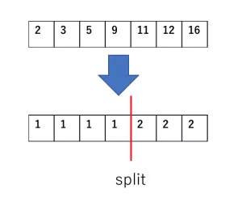
Question…reworded
What feature will allow me to split the observations at hand in a way that the resulting groups are as different from each other as possible (and the members of each resulting subgroup are as similar to each other as possible)?

Slide 16
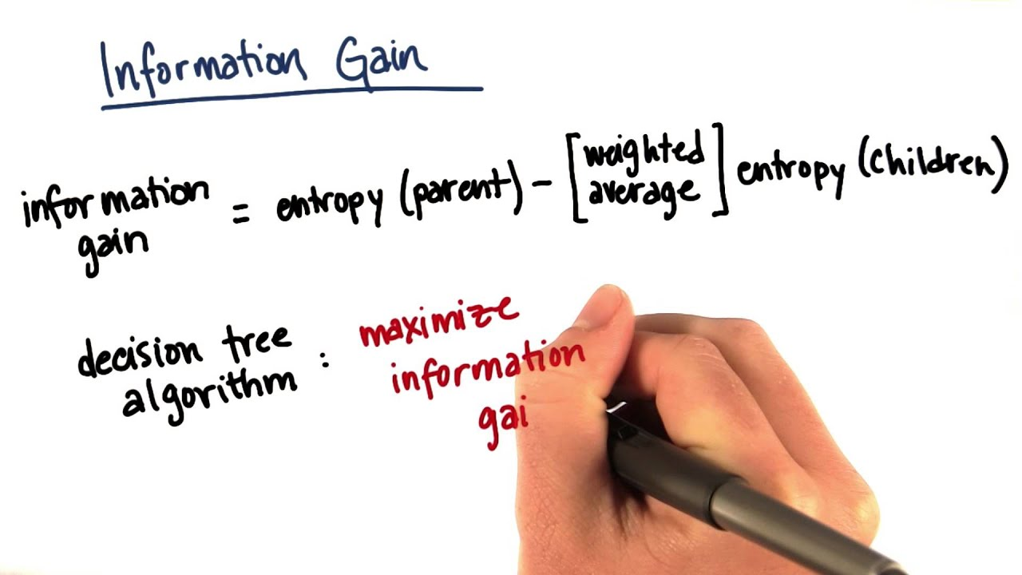
Feature Selection
The previous question is the purpose of Feature Selection.
We want to pick features that
give us the maximum amount of information gain when splitting at a node in the tree.

Slide 17

Information Gain
Tells us how much information we have gained by splitting a node of the tree at a given attribute….
We want to pick something that separates the groups as much as possible and therefore would tell us more about the groups.

Slide 18
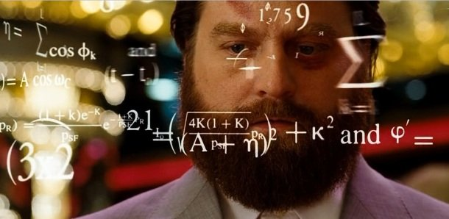
Split Criterion
Helps decide how “good” of a split we get from an attribute in a decision tree

Slide 19
Split Criterion: Types
Three types that can be used to measure Information Gain:
Classification Error
Entropy
Gini Index

Slide 20
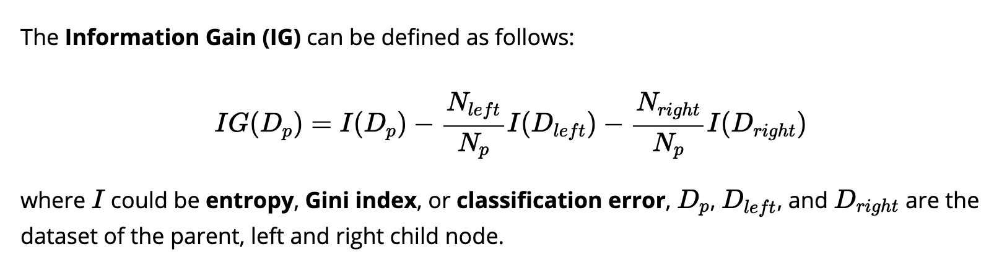
Information Gain Formula

Slide 21
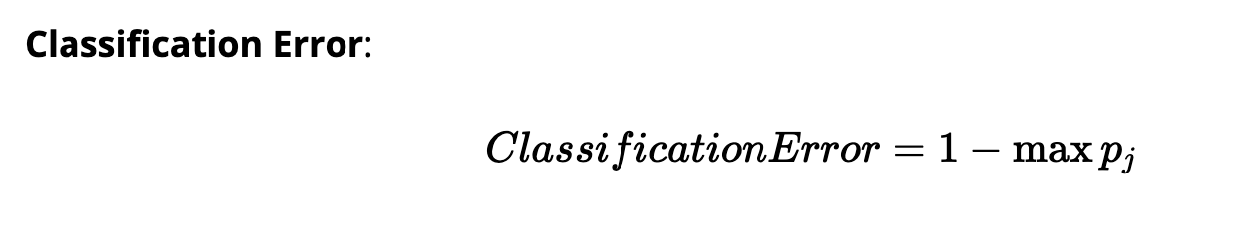
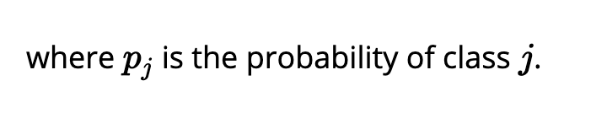
Classification Error Formula

Slide 22
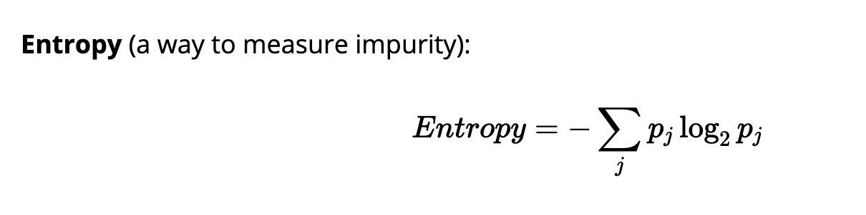
Entropy Formula
Also referred to as Entropy Information Gain

Slide 23
Entropy Explained
Entropy = 0 if all samples in a node belong to the same class
This is because log(1) = 0 where the probability = 1 because we are guaranteed that the sample is of a certain class

Slide 24
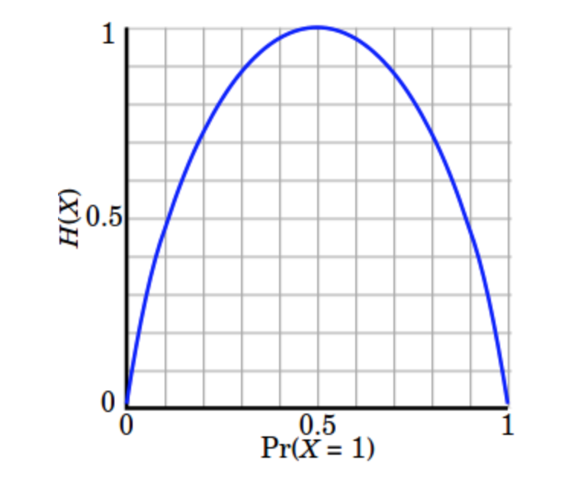
Entropy Explained

Slide 25
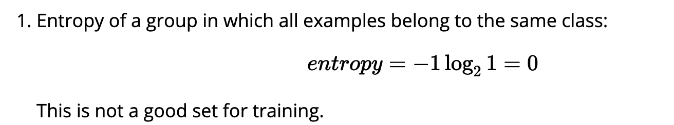
Entropy Explained

Slide 26
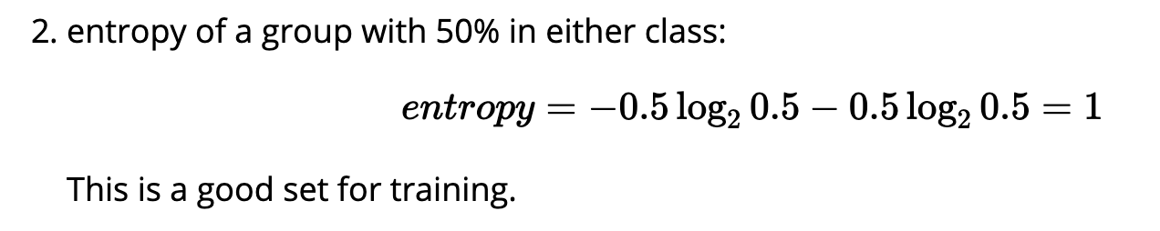
Entropy Explained

Slide 27
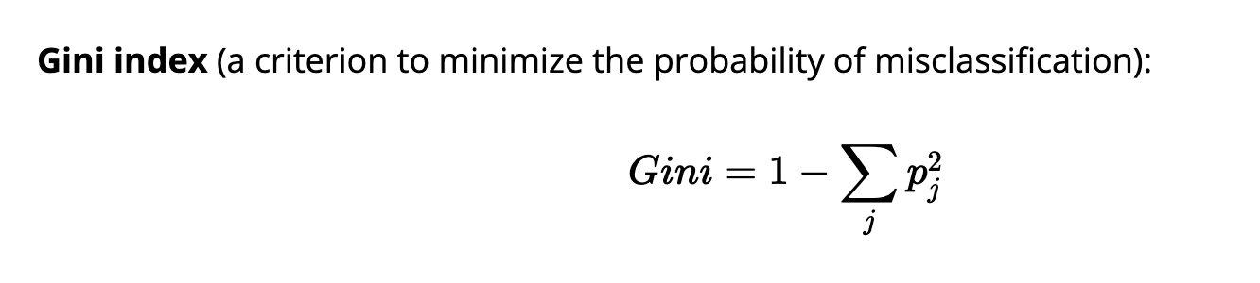
Gini Index Formula

Slide 28
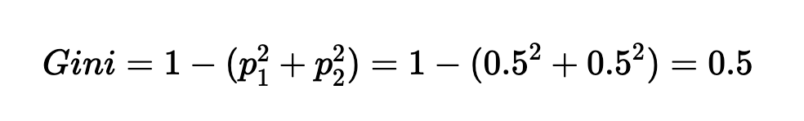
Gini Index Explained
Also referred to as Gini Impurity
Very similar to Entropy
Maximized when classes are evenly mixed

Slide 29
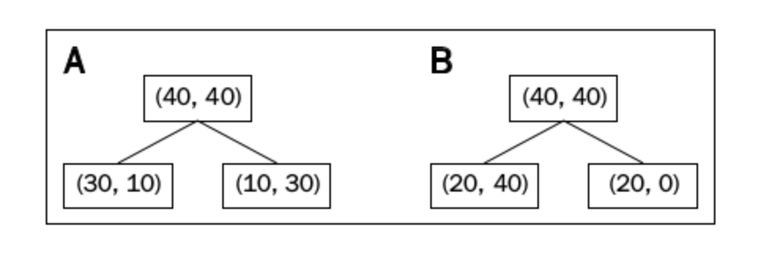
Bring it All Together

Slide 30
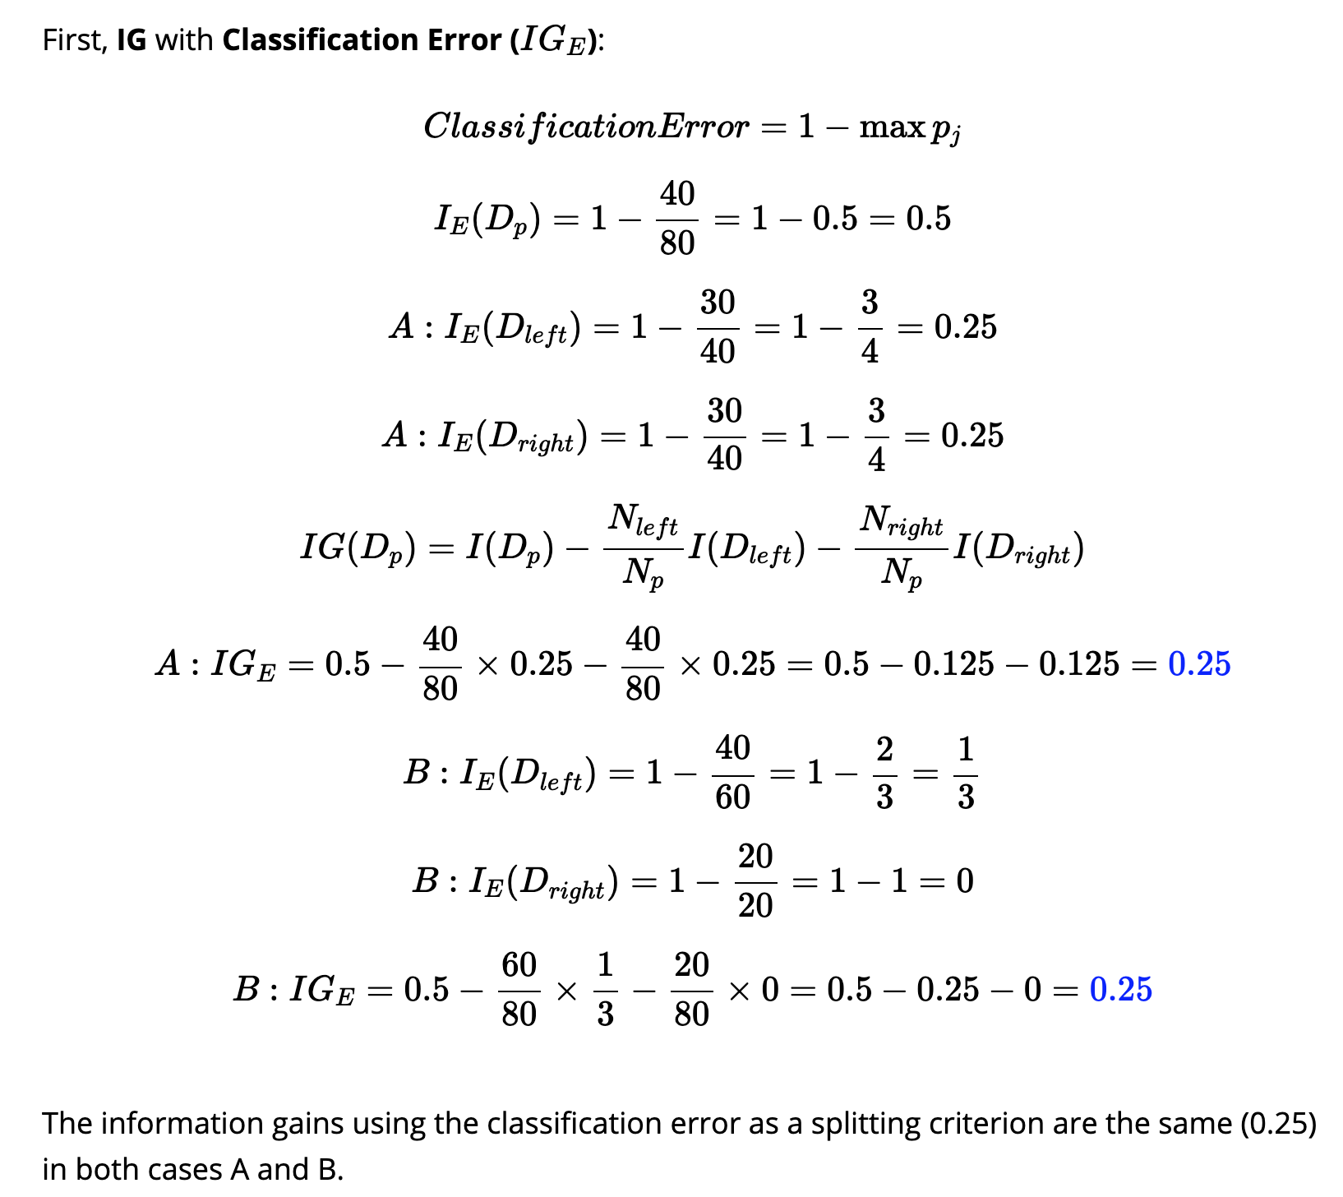
Bring it All Together – Classification Error

Slide 31
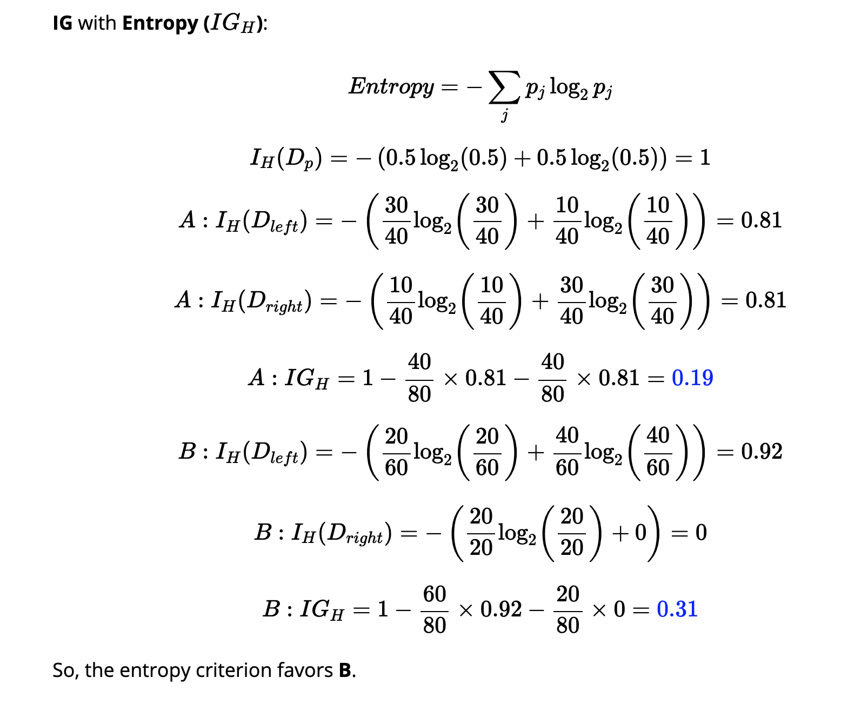
Bring it All Together – Entropy

Slide 32
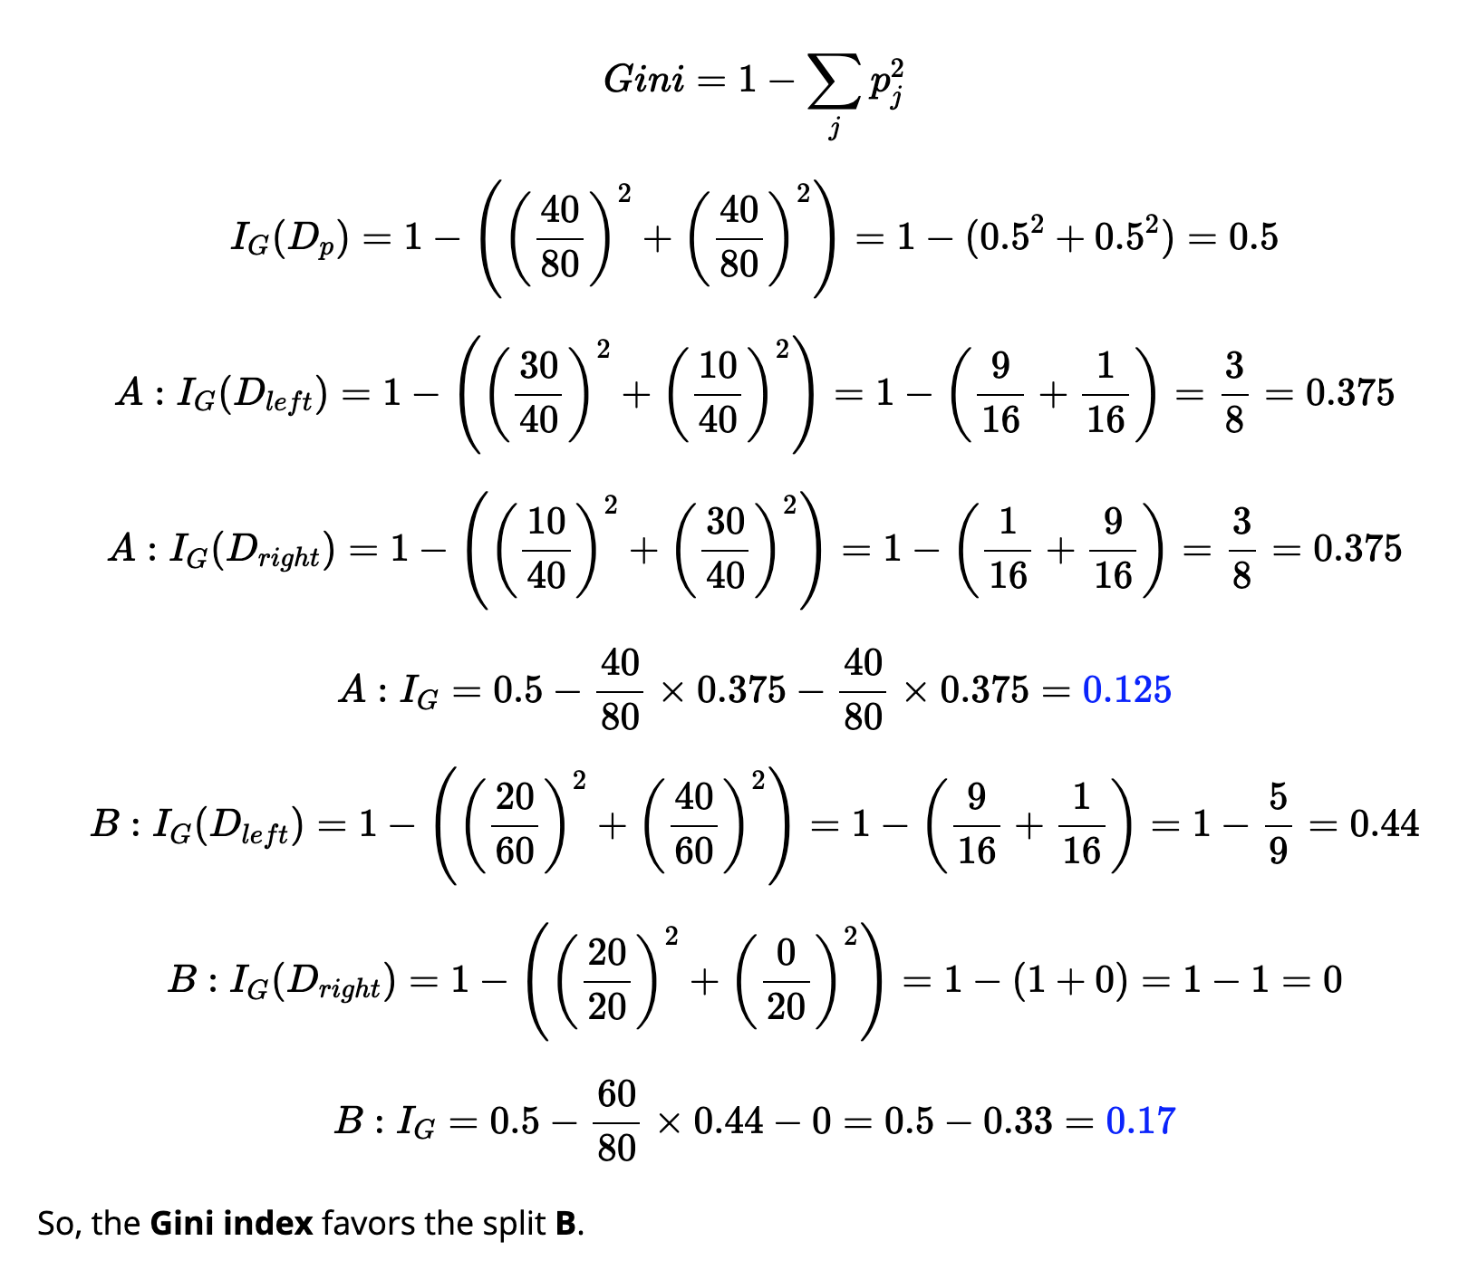
Bring it All Together – Gini Index

Slide 33
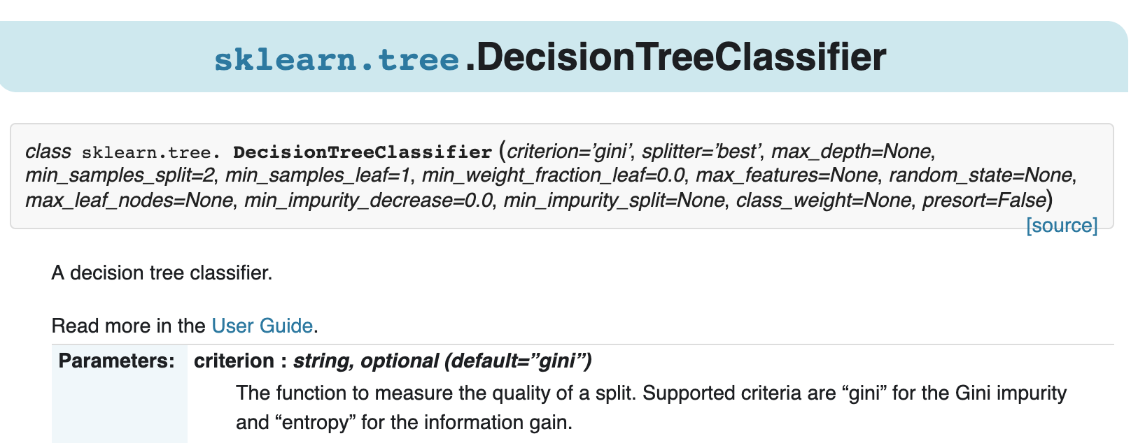
Sklearn Learn

Slide 34
Example Defined Functions
import matplotlib.pyplot as plt
import numpy as np
def gini(p):
return (p)*(1 - (p)) + (1 - p)*(1 - (1-p))
def entropy(p):
return - p*np.log2(p) - (1 - p)*np.log2((1 - p))
def classification_error(p):
return 1 - np.max([p, 1 - p])

Slide 35
Gini vs. Entropy Demonstration
Walk-through example
https://thatascience.com/learn-machine-learning/gini-entropy/

Slide 36
Proof Paper Gini vs. Entropy
https://www.unine.ch/files/live/sites/imi/files/shared/documents/papers/Gini_index_fulltext.pdf

Slide 37
Which is Preferred?
Gini is usually preferred over Entropy for computing power’s sake.
Entropy has to compute log function
Both perform with essentially same accuracies and choose same splits with very rare differences (paper outlines never more than 2% of cases show differences)

Slide 38
References
https://www.ibm.com/support/knowledgecenter/en/SS3RA7_15.0.0/com.ibm.spss.modeler.help/nodes_treebuilding.htm
https://towardsdatascience.com/understanding-random-forest-58381e0602d2
https://www.bogotobogo.com/python/scikit-learn/scikt_machine_learning_Decision_Tree_Learning_Informatioin_Gain_IG_Impurity_Entropy_Gini_Classification_Error.php
https://blog.quantinsti.com/gini-index/
https://scikit-learn.org/stable/modules/generated/sklearn.tree.DecisionTreeClassifier.html
https://dataaspirant.com/2017/01/30/how-decision-tree-algorithm-works/

